Slide 1

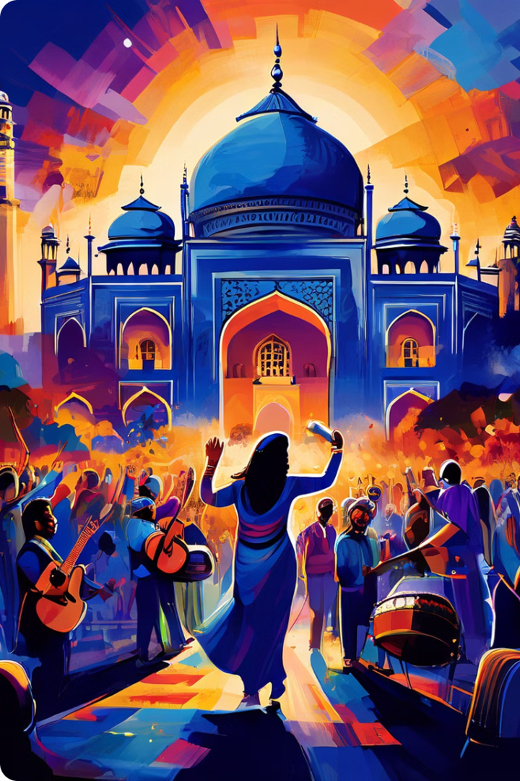
YouTube Data Analysis
This presentation explores the evolving world of Indian music on YouTube, analyzing its trends, popularity, and cultural impact. We delve into the data, revealing insights into the music that resonates with millions across India and beyond.

Slide 2

Chart-Topping Hits: Most Popular Indian Songs on YouTube
Rank
Song Title
Artist
Views (Millions)
1
Kesariya
Arijit Singh
1000+
2
Nacho Nacho
Arijit Singh, Jonita Gandhi
500+
3
Bijli Bijli
Harrdy Sandhu
400+
4
Lehren
Arijit Singh, Shreya Ghoshal
300+
5
Raataan Lambiyan
Jubin Nautiyal, Asees Kaur
200+

Slide 3
Beyond Bollywood: Exploring India's Diverse Musical Landscape
Classical Music
Folk Music
Modern Music
Classical music is deeply rooted in tradition, with a rich history spanning centuries. Raga and Tala, the fundamental elements of Indian classical music, create a complex and nuanced musical experience.
Folk music is a vibrant tapestry of local traditions and stories, often featuring simple instruments and captivating melodies. It reflects the rural life, customs, and beliefs of various communities.
Modern music encompasses a wide range of genres, including pop, rock, hip hop, and electronic music. It often incorporates elements of traditional Indian music, creating a fusion of old and new sounds.

Slide 4
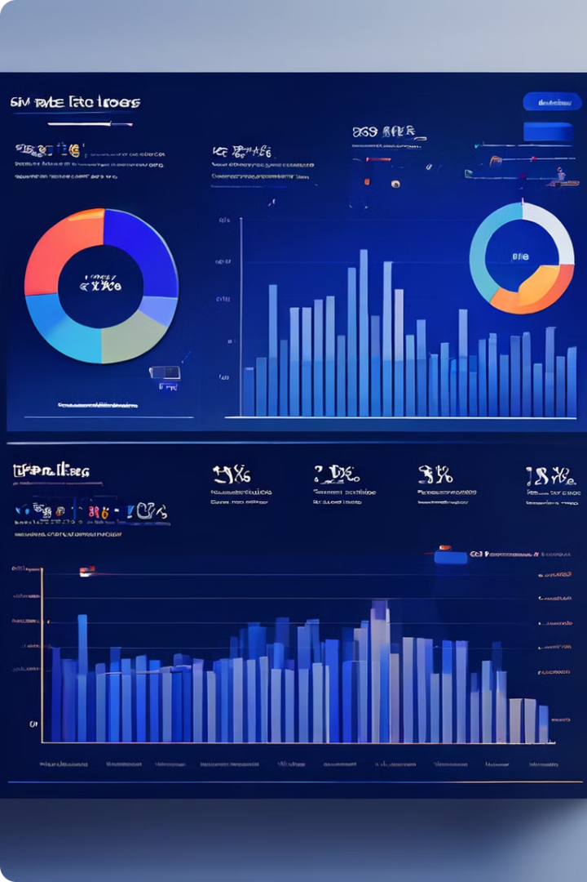
Measuring Success: Views, Likes, Comments, and Beyond
1
Views
The number of times a video has been watched, providing a direct measure of reach and popularity.
2
Likes
An indicator of audience approval, expressing positive sentiment and engagement with the content.
3
Comments
A platform for audience interaction, providing insights into their thoughts, opinions, and reactions to the music.
4
Engagement
A broader metric encompassing views, likes, comments, shares, and other forms of audience interaction.

Slide 5

The Rise of Indian Music: Analyzing Trends Over Time
Growth of Streaming Platforms
Early Days
The rise of streaming platforms like Spotify and Apple Music, alongside YouTube Music, further expanded the reach of Indian music, providing easy access to a vast library of songs.
The early days of YouTube saw Bollywood music dominate the platform, with music videos and film soundtracks attracting a large audience.
1
2
3
4
Rise of Independent Artists
Global Recognition
The emergence of independent artists, often showcasing unique styles and genres, brought diversity to the platform, catering to a wider range of musical tastes.
Indian music has gained global recognition, with artists like AR Rahman, A.R. Rehman, and Pritam garnering international acclaim and collaborations.

Slide 6

Decoding Popularity: What Makes a Song Go Viral?
Catchy Lyrics
Lyrics that are relatable, memorable, and easily sung along to can significantly contribute to a song's virality.
Engaging Music Videos
High-quality music videos with captivating visuals, compelling narratives, and creative choreography can enhance a song's appeal.
Strong Collaborations
Collaborations between popular artists can create buzz and attract new audiences, expanding the song's reach and potential for virality.
Effective Marketing Strategies
Targeted marketing campaigns, including social media promotion, influencer partnerships, and strategic collaborations, can drive awareness and engagement for a song.

Slide 7
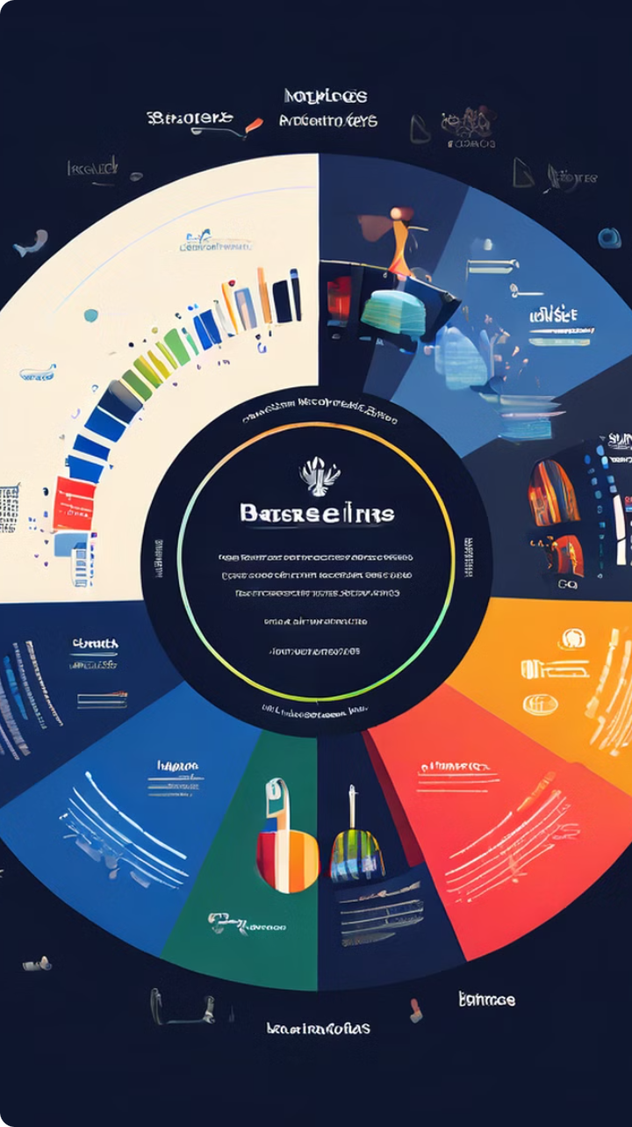




Genre Preferences: India's Favorite Musical Flavors
Bollywood
Bollywood music remains a dominant force, with its catchy tunes, emotional depth, and captivating narratives continuing to attract a large audience.
Pop
Indian pop music offers a contemporary and energetic sound, often incorporating elements of electronic music, hip hop, and R&B.
Indie
Indie music showcases a diverse range of independent artists exploring experimental sounds, unique lyrics, and innovative musical arrangements.
Classical
Classical music continues to hold a significant place in Indian culture, with its rich traditions and complex compositions captivating listeners.

Slide 8




Regional vs. National: Mapping India's Musical Tastes
Regional Music
Regional music reflects the unique cultural identity and traditions of different states and regions within India.
National Trends
National trends in music, often driven by Bollywood, pop, and other popular genres, are increasingly influencing regional tastes.
Fusion & Collaboration
Fusion music, combining elements of regional and national styles, is gaining popularity, bridging the gap between different musical traditions.

Slide 9
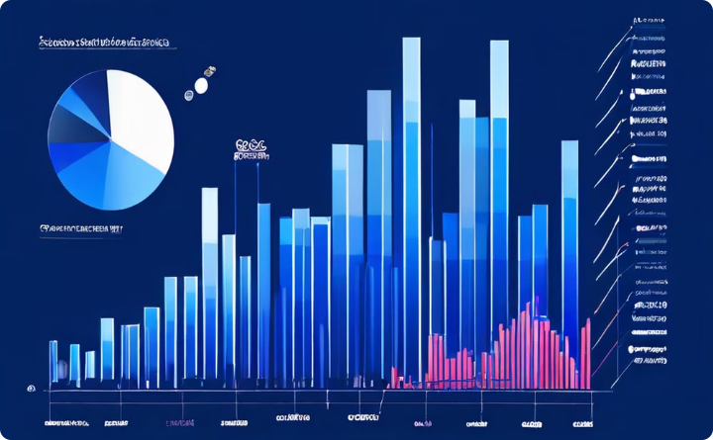
The Power of Collaboration: Impact on Song Popularity
Collaborative Success
Increased Engagement
Collaborations often result in fresh and innovative sounds, attracting new listeners and boosting the popularity of both artists involved.
Collaborations can significantly enhance a song's reach and engagement, as fans of both artists are drawn to the unique combination of talents.

Slide 10

Visual Elements: Captivating Artwork and Music Videos
Music videos play a crucial role in enhancing the visual experience of Indian music, captivating audiences with their creative storytelling, vibrant visuals, and captivating choreography.

Slide 11
